Slide 1

Email speech assistant
VOICE ASSISTANT
Under guidance of
Dr. Figlu Mohanty

Slide 2
TEAM MEMBERS
2110030014 – G. Haritha Maithreyee
2110030032 – D. Neha
2110030056 – B. Akshita
2110030457 – V. Charishma
2110030067 – A. .Bhavya Sri

Slide 3

INTRODUCTION
Speech Recognition is a branch of Computer Science and Computational Linguistics. It’s a field that develops methodologies that allow computers to translate speech inputs into written text.
As the name implies, this technology allows recognizing the user’s voice commands and their conversion into the text to be processed by the system.
Once translated, that information goes through the same processing as a written text message in a “normal” chatbot.

Slide 4
Artificial Intelligence (AI) is the ability of a computer or a robot controlled by a computer to do tasks that are usually done by humans because they require human intelligence
Email Bot use AI-powered speech recognition to provide voice-to-text conversion
DOMAIN ANALYSIS

Slide 5
Software and hardware requirements
Software Requirements:
Programming Language: Python 3.9
Tools: Anaconda or PyCharm
Operating System: Windows
Hardware Requirements:
RAM: 2GB or above
Processor: i3 or above
Processor speed: 2.4GHz
Hard disk: 500GB

Slide 6
IMPLEMENTATION
import smtplib
server=smtplib.SMTP('smtp.gmail.com',587)
server.starttls()
server.login("saisoumyadevineedi27@gmail.com","wvivnquyyybqzxqc")
server.sendmail("saisoumyadevineedi27@gmail.com","pasn09@gmail.com","hello good morning")
def hello():
import smtplib
import speech_recognition as sr
listener=sr.Recognizer()
try:
with sr.Microphone() as source:
print("listening...")
voice=listener.listen(source)
info=listener.recognize_google(voice)
print(info)
except:
pass

Slide 7
Pyttsx3 module
pyttsx3 is a text-to-speech conversion library in Python. Unlike alternative libraries, it works offline and is compatible with both Python 2 and 3. An application invokes the pyttsx3. init() factory function to get a reference to a pyttsx3

Slide 8
Python comes with the built-in smtplib module for sending emails using the Simple Mail Transfer Protocol (SMTP) . the smtplib module defines an smtp client session object that can be used to send mail to any internet machine with an SMTP or ESMTP listener daemon.
Smtplib module

Slide 9
REFERENCES
https://avleonov.com/2019/02/18/how-to-make-email-bot-service-in-python
https://www.citethisforme.com/topic-ideas/technology/chatbot-23911731
https://medium.com/mailbots/introducing-mailbots-bots-for-email-41602dd145d0
https://www.visor.ai/email-bots-how-to-automate-your-mailbox/

Slide 10
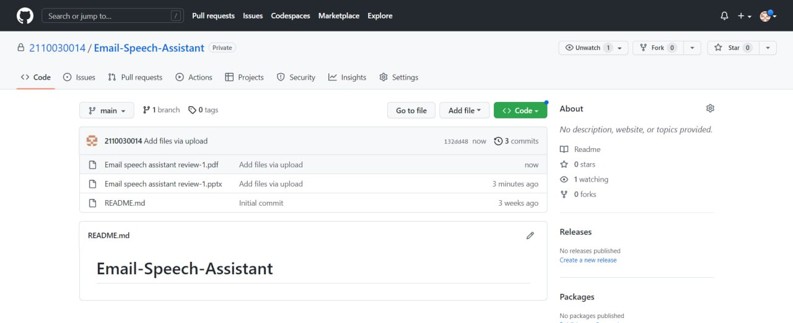
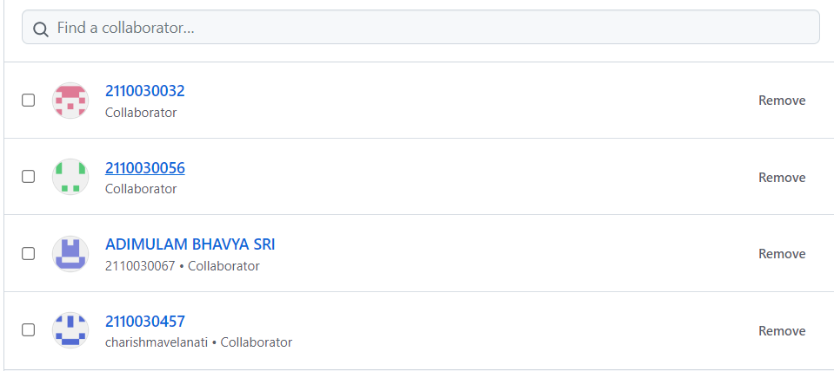
GITHUB
https://github.com/2110030014/Email-Speech-Assistant/

Slide 11
Thank You

